Slide 1
SAMPLE SIZE CALCULATION AND RECALCULATION FOR NON-INFERIORITY TRIALS
in the “gold standard” design with heterogeneous variances Maxi Schulz, Tobias Mütze, Tim Friede

Slide 2
MOTIVATION
Experimental
Reference
Placebo
Non-inferiority trials
“gold standard” design
Heterogeneous variances
Methods for analysis
Parametric test (Hasler et. al. 2008)
Studentized permutation test (Mütze et. al. 2017)
Sample size planning
1
Propose a sample size planning method
Notes:
Introduce to setting
Rather than showing superiority, in non-inferiority trials we want to show that a new treatment is not clinically worse than a standard (reference) treatment.
Because: The new treatment may present advantages such as reduced toxicity, improved administration, or lower cost compared to standard treatments.
One may use two-arm designs, but two-arm designs often lack the ability to distinguish between an effective and ineffective treatment, also known as assay sensitivity
Therefore recommended: three-arm designs including additionally placebo arm, also referred to as “Gold standard“ design
In such three-arm designs it is reasonable to assume differing variances between the three groups -> Heterogeneous variance scenario

Slide 3
MODEL
Let
$X_{ik}$ denote the observations of group$i=E, R, P$ with$k=1, …, n_{i}$,
smaller values be associated with higher treatment effect, and
$∆$ denote the pre-specified non-inferiority margin = minimum fraction of the reference treatment that the experimental treatment effect needs to preserve
Notes:
Delta typically chosen as 80%

Slide 4
HYPOTHESIS TESTING
The statistical testing problem of non-inferiority can be formulated as
$$H_{0}: \frac{μ_{P}− μ_{E}}{μ_{P}−μ_{R}} ≤ ∆ \text{vs}\text{. }H_{1}: \frac{μ_{P}− μ_{E}}{μ_{P}−μ_{R}}>∆.$$
The Wald-type statistic $T_{n}$ can be derived as
$T_{n}=\sqrt{n} \frac{{\overline{X}}_{E∙}−∆{\overline{X}}_{R∙}−(∆−1){\overline{X}}_{P∙}}{\hat{σ}}$ with $\hat{σ}=\sqrt{\frac{{\hat{σ}}_{E}^{2}}{w_{E}}+ ∆^{2}\frac{{\hat{σ}}_{R}^{2}}{w_{R}}+{(1−∆)}^{2}\frac{{\hat{σ}}_{P}^{2}}{w_{P}}}$
Retention-of-effect
Hypothesis
Notes:
Where experimental and reference are both compared to placebo, Difference in experimental measured in difference in reference as a ratio and then compared to our pre-specified Delta
(Under the alternative hypothesis, the experimental treatment achieves more than 80% of the efficacy of the reference treatment where the experimental and reference treatment are each compared to placebo.)
Re-arranging the hypothesis and substituting the parameters by their estimates

Slide 5
THE TESTING PROCEDURES
THE HASLER TEST
Assumes $X_{ik}\sim 𝒩(μ_{i}, σ_{i}^{2})$
Distribution of $T_{n}$under $H_{0}$ is approximated by$t({\hat{ν}}^{het})$
Derives a test decision based on the $α$-quantile of $t$-distribution with ${\hat{ν}}^{het}$degrees of freedom
THE STUD. PERMUTATION TEST
data is permutated to approximate the distribution $T_{n}$under $H_{0}$
Derives a test decision based on the $α$-quantile of the permutation distribution
Notes:
For the studentized permutation test: rather than using parametric assumptions on the distribution of the test statistic, the data is permutated to approximate the distribution under the null hypothesis.
permutation distribution = the distribution of the test statistic based on the permutated data

Slide 6
USE OF THE HASLER SAMPLE SIZE PLANNING PROCEDURE
Denote $β$ as the type II error rate and $m_{i}= {n_{i}}/{n_{E}}$.
Then, $n_{E}$ is given by the smallest $n_{E}$ for which
$n_{E}≥{\left(t_{α}\left(ν^{het}\right)− t_{β}\left(ν^{het}\right)\right)}^{2}\frac{σ_{E}^{2}+ \frac{Δ^{2}}{m_{R}}σ_{R}^{2}+ \frac{{\left(1−Δ\right)}^{2}}{m_{P}}σ_{P}^{2}}{(μ_{E}− Δμ_{R}−\left(1− Δ\right)μ_{P})²}$ holds (1),
where $ν^{het}$ is a function of $n_{E}$.
The solution is derived iteratively.

Slide 7
SIMULATION STUDY
Study the proposed sample size planning procedure by comparing the simulated power of the studentized permutation test to the approximate power function
$\text{for} \text{different} \text{data}\text{−}\text{generating} \text{mechanisms}\text{:} 𝒩$, $t(4)$, log-$𝒩$, $χ²$
for increasing $\frac{μ_{P}− μ_{E}}{μ_{P}−μ_{R}}$
Notes:
Our suggestion: if simulated power and approximate power coincide, then approximate power fct can also approximate the power of the studentized permutation test and hence, can be used as a sample size planning method

Slide 8
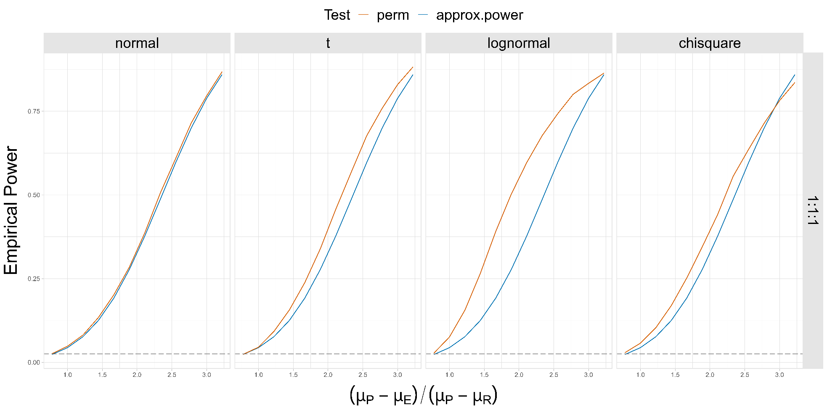
Applicable for symmetric data
Not applicable for skewed data
Transformation of the data
Notes:
Figure shows part of simulation results in the balanced group design
Columns represent the underlying data distributions
Orange = permutation test, blue = approximated power fct of the hasler test
Very few deviations in the case of normal data
For non-normal data, the simulated power curves are steeper
For t-distributed data the least deviation
Für chi2-data : steeper but then flattens out more quickly
For lognormal: for greatest
Method not applicable for skewed data (transformation of the data needed)
Applicable for symmetric data (heavier tails do not seem to pose a challenge)

Slide 9
SAMPLE SIZE CALCULATION
The Hasler sample size planning procedure (1) requires the specification of the
treatment effects $μ_{i}$,
α and β-error
variance parameters $σ_{i}^{2}$
Failing to adequately specify parameters potentially results in underpowered or overpowered trials.
Notes:
Specifically here: we look at nuisance parameters (variances)
Variance specification for the three groups is often subject to greater uncertainty

Slide 10
SAMPLE SIZE RE-ESTIMATION BASED ON INTERNAL PILOT STUDY DATA
Internal pilot data with $n_{1}$
Estimate variances
Re-estimate sample sizes using (1)
Notes:
To account for misspecifications, trial designs might allow that the initially planned sample size is adjusted while the trial is in progress
One might use the data of an internal pilot study, estimate the variances and re-estimate the final sample size accordingly

Slide 11
SAMPLE SIZE RE-ESTIMATION BASED ON INTERNAL PILOT STUDY DATA
Using a blinded variance estimator, we estimate ${\hat{σ}}_{n_{1}}^{2}$
Deriving estimates for the single group variances ${\hat{σ}}_{n_{1}, i}^{2}$ requires unblinding of the data
Heterogeneous variances
2
Derive re-estimation procedure that allows for heterogeneous variances
Notes:
Blinded => estimate of the total variance of the internal pilot study
Single group variances => requires unblinding
Therefore, heterogeneous variance scenarios pose a challenge for blinded sample size re-estimation
Second goal of this work is to provide a framework for allowing heterogeneous variances in sample size re-estimation
This applies to both testing procedures
Various sample size re-estimating strategies were studied for the two-arm design for normally distributed endpoints and one study by Mütze & Friede in three-arm design, but only for homogeneous variances
Since unblinding the data possibly introduces a bias to the study and is generally not recommended by regulators, variance estimators that maintain the blinding of the internal pilot data should generally be preferred over unblinded variance estimates.

Slide 12
ALLOWING FOR HETEROGENEOUS VARIANCES WITHOUT UNBLINDING
In heterogeneous variance scenarios, $σ^{2}= σ_{E}^{2}{ w}_{E}+ σ_{R}^{2}{ w}_{R}+ σ_{P}^{2}{ w}_{P}$, with $w_{i}= {n_{i}}/n$
Let $c_{R}={σ_{R}^{2}}/{σ_{E}^{2}}$ and $c_{P}={σ_{P}^{2}}/{σ_{E}^{2}}$. Then, one can derive $σ_{E}^{2}$ by
$$σ_{E}^{2}= {σ^{2}}/{(w_{E}+ c_{R}w_{R}+ c_{P}w_{P})}.$$
From $σ_{E}^{2}$, the group variances $σ_{R}^{2}$ and $σ_{P}^{2}$ can be derived using $c_{R}$and $c_{P}$
Assuming the ratios in the group variances is sufficient to allow for blinded sample size re-estimation.
Notes:
The framework goes as follows:
Sigma2 can be decomposed into the single group variances sigma^2_i and the proportion of the group sample sizes on the total sample size
Let the reference and placebo variance as proportions on the experimental variance
By rearranging we can derive sigma2_e
Using c_r and c_p we can then derive sigma2r and sigma2p accordingly
That means: In blinded sample size re-estimation we derive estimates for the total variance. If additionally we know the ratios in the group variances (c_r and c_p) we can derive estimates for the single group variances.
Assuming the ratios in the group variances is sufficient to allow for blinded sample size re-estimation.

Slide 13
SIMULATION STUDY
Assess performance of the proposed procedure by means of power and type I error rate
normal data with fixed $\frac{μ_{P}− μ_{E}}{μ_{P}−μ_{R}}$ , and group variance ratio $\left(1;c_{R}; c_{P}\right)$ = (1;1;0.5),
target power level of 0.8
assumed variances ($σ_{E∗}^{2};σ_{R∗}^{2};σ_{P∗}^{2}$) = (1;1;0.5)
true variances ${(σ}_{E}^{2};σ_{R}^{2};σ_{P}^{2})=$(1.5;1.5;0.75)
Comparing unblinded variance estimates (UG) with blinded variance estimates (OSU)
increasing internal pilot study size $n_{1}$
Using additionally $\left(1;c_{R}; c_{P}\right)$

Slide 14
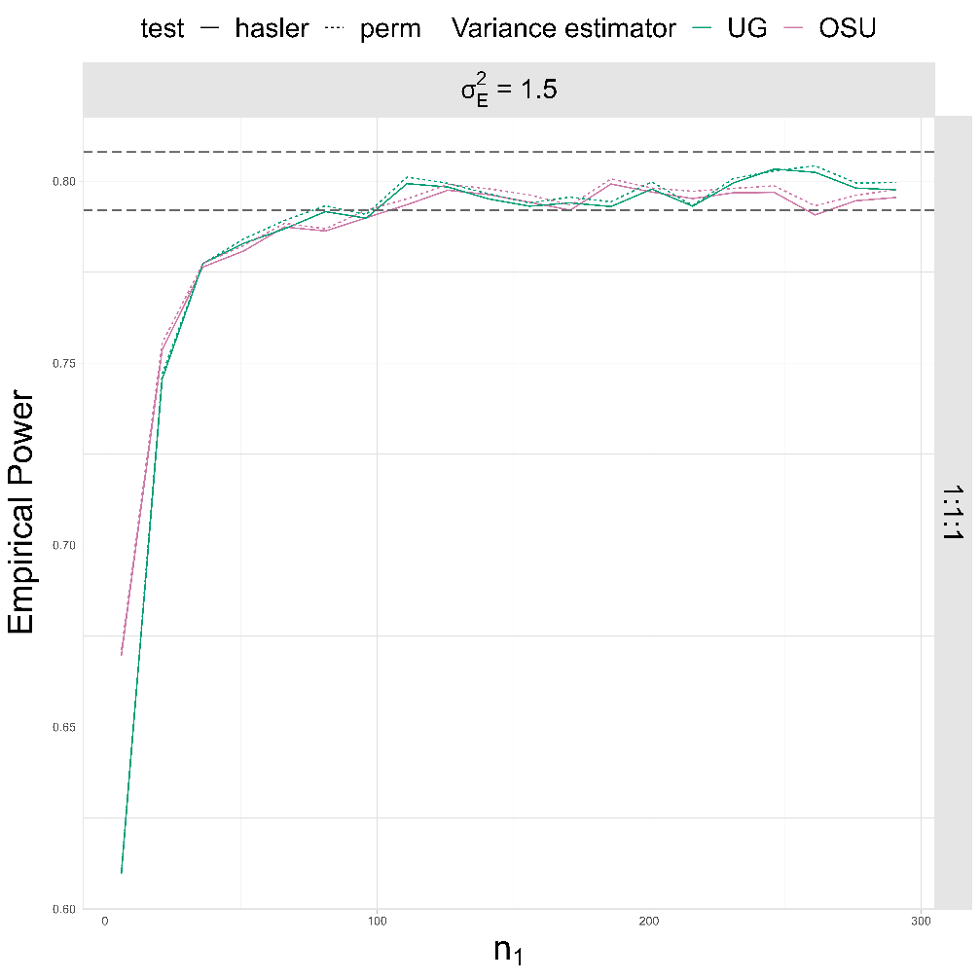
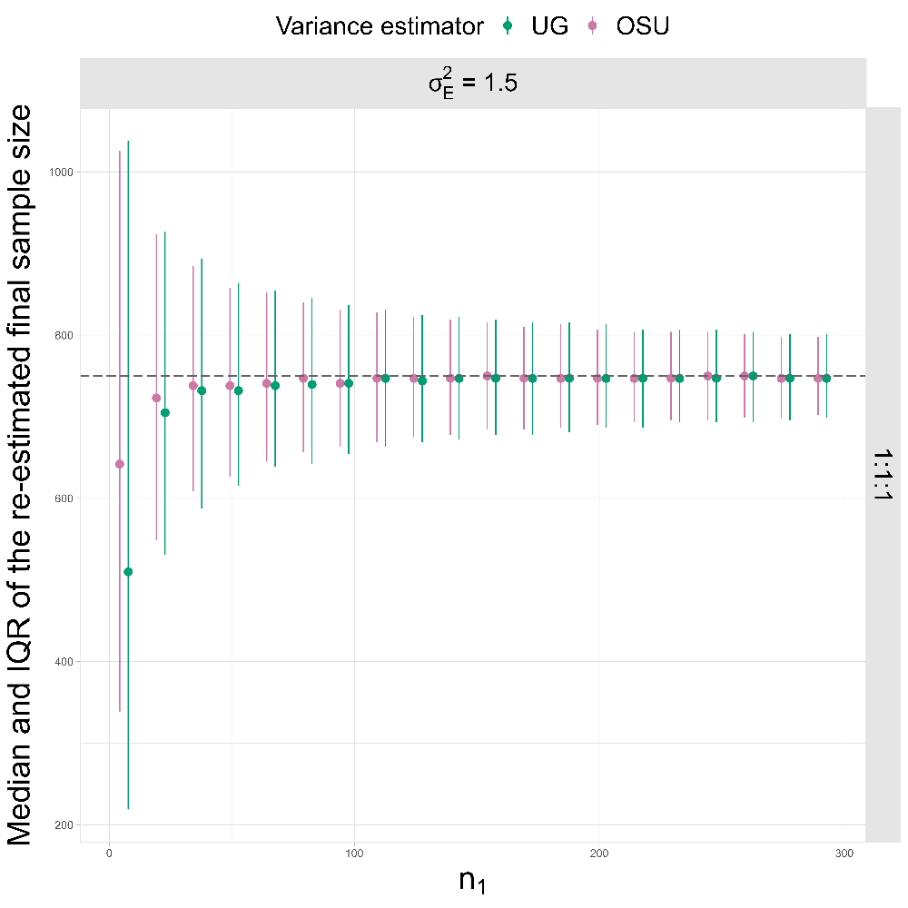
The group variances ratio is sufficient to maintain the blinding of the data and ensure reliable sample size re-estimation (for greater $n_{1}$)
Notes:
Part of simulation results: balanced design
Plot 1: both re-estimation procedures reach the target power level for greater n1, both re-estimation procedures work similarly
Plot 2: Re-estimation of final sample size becomes more reliable with increasing n1
Conclusion: Knowing the ratio is sufficient to ensure blinding of the data

Slide 15
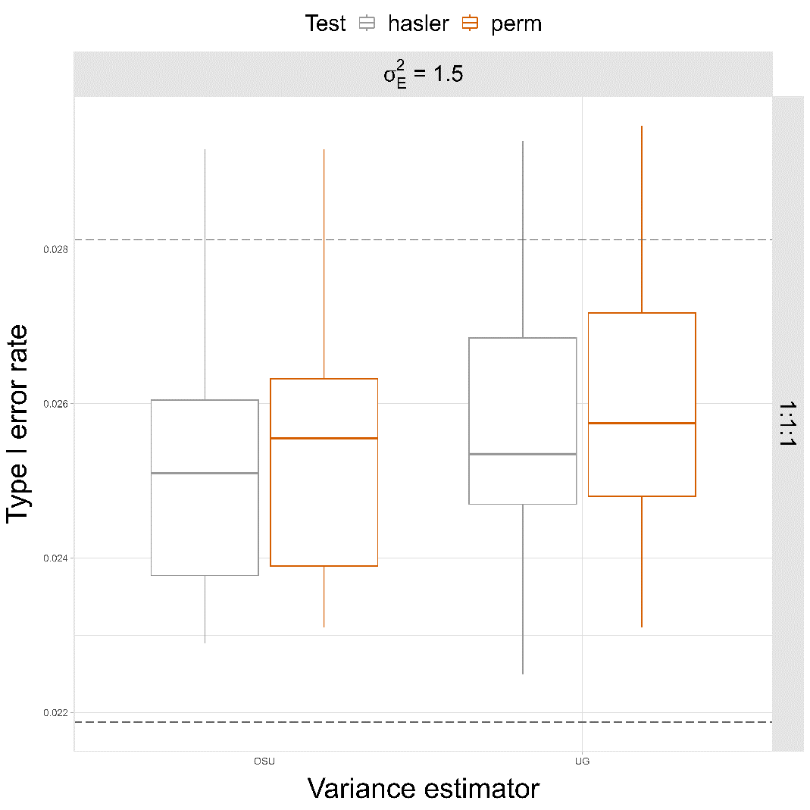
Notes:
From a regulatory point of view, it is important that a sample size re-estimation procedure controls for the type I error rate
Plot shows XX scenarios (est, test, n1)
We can observe a very slight inflation of the type I error rate in regard to the pre-specified alpha-level for both procedures
Inflation seems to be marginally larger for the studentized permutation test
That is similar to the findings made in two-arm trials with blinded sample size re-estimation that found inflation of the type I error rate in non-inferiority testing
However, the potential inflation is not practically relevant.
Additionally, we suppose that this inflation is controllable for superiority testing (like in two-arm designs)
procedures for controlling the type I error rate in designs with sample size re-estimation based on an internal pilot study have been suggested and can be applied easily to the SSR procedure proposed in this study (nachgucken)

Slide 16
SUMMARY AND CONCLUSION
The sample size planning procedure by Hasler et.al (2008) serves as a good approximation for the required sample sizes when analysing with the studentized permutation test for symmetric data
Specifying the group variance ratio is sufficient to ensure blinded sample size re-estimation
Sensitivity to misspecification of group variance ratio?
Sample size re-estimation procedures are associated with a slight increase in the type I error rate

Slide 17
SOME REFERENCES
M. Hasler, R. Vonk, and L. A. Hothorn. Assessing non-inferiority of a new treatment in a three-arm trial in the presence of heteroscedasticity. Statistics in Medicine, 27(4):490–503, 2008. doi: 10.1002/sim.3052.
T. Mütze, F. Konietschke, A. Munk, and T. Friede. A studentized permutation test for three-arm trials in the ’gold standard’ design. Statistics in Medicine, 36:883–898, 2017. doi: 10.1002/sim.7176.
M. Kieser and T. Friede. Simple procedures for blinded sample size adjustment that do not affect the type i error rate. Statistics in Medicine, 22(23):3571–3581, 2003. doi: 10.1002/sim.1585
T. Mütze and T. Friede. Blinded sample size re-estimation in three-arm trials with ’gold standard’ design. Statistics in Medicine, 36(23):3636–3653, 2017. doi: 10.1002/sim.7356.
T. Mütze. ThreeArmedTrials: Design and Analysis of Clinical Non-Inferiority or Superiority Trials with Active and Placebo Control, 2023. URL https://CRAN.R-project.org/package=ThreeArmedTrials. R package version 1.0-5.

Slide 18
APPENDIX
$ν^{het}= \frac{\left(\frac{1}{n_{E}}σ_{E}^{2}+ \frac{Δ^{2}}{n_{R}} σ_{R}^{2}+ \frac{(1−∆)²}{n_{P}}σ_{P}^{2}\right)²}{\frac{1}{n_{E}^{2}(n_{E}^{2}−1)}σ_{E}^{4}+ \frac{∆^{4}}{n_{R}^{2}(n_{R}^{2}−1)}σ_{R}^{4}+\frac{(1−∆^{4})}{n_{P}^{2}(n_{P}^{2}−1)}σ_{P}^{4} }$
Estimating the unknown parameters yields ${\hat{ν}}^{het}$

Slide 19
APPENDIX: MOTIVATING EXAMPLE
 | Experimental (E) | Reference (R) | Placebo (P)
A trial in patients with type 2 diabetes (Pratley et al. 2019)
 | Oral semaglutide | Subcutaneous liraglutide | Placebo
N | 278 | 272 | 134
Mean change in ${HbA}_{1C}$ from baseline to week 26 (SD) | -1.2 % (1.67) | -1.1 % (1.65) | -0.2 % (1.16)
Effect on blood sugar levels
A lower mean change is associated with a higher treatment effect
2:2:1 group design
Notes:
Trial example from patients with type 2 diabetes (PIONEER 4, Phase 3a clinical trial)
Oral semaglutide, a novel GLP-1 agonist, is compared with subcutaneous liraglutide and placebo
Investigated: effect of lowering blood sugar levels, measured in glycated haemoglobin
Here we have the data on the change from baseline to week 26
The lower the mean change, the better
Participants are randomised in a 2:2:1 group design.

Slide 20
APPENDIX: THE STUDENTIZED PERMUATION TEST
Let $X_{ik}\sim F_{i}$ with finite mean $𝔼\left[X_{ik}\right]= μ_{i}$, finite positive variance $Var\left[X_{ik}\right]=σ_{i}^{2}$ and finite fourth moment $𝔼\left[X_{ik}^{4}\right]$
For a given significance level $α∈\left(0,1\right),$the function $φ_{n}^{Perm}$ refers to the studentized permutation test with
$φ_{n}^{Perm}\left(X_{n}\right)= \left\{\begin{aligned}1 T_{n}\left(X_{n}\right)<c_{n}\left(α\right) \\ 0 T_{n}\left(X_{n}\right)≥c_{n}\left(α\right)\end{aligned}\right.$
with$c_{n}\left(α\right)$ denoting the $α$-quantile of the permutation distribution
Notes:
Rather than using parametric assumptions on the distribution of the test statistic, the data is permutated to approximate the distribution under the null hypothesis. Permutation of the data, the test statistic is then again calculated based on the permutated data. Repeated X times. Forms the distribution of the test statistic based on the permutated data
permutation distribution = the distribution of the test statistic based on the permutated data

Slide 21
APPENDIX: THE HASLER TEST
Let $X_{ik}\sim 𝒩(μ_{i}, σ_{i}^{2})$
For a given significance level $α∈\left(0,1\right),$the function $φ_{n}^{Hasler}$ refers to the Hasler test with
$φ_{n}^{Hasler}\left(X_{n}\right)= \left\{\begin{aligned}1 T_{n}\left(X_{n}\right)<t_{α}\left({\hat{ν}}^{het}\right) \\ 0 T_{n}\left(X_{n}\right)≥t_{α}({\hat{ν}}^{het})\end{aligned}\right.$
with$t_{α}\left({\hat{ν}}^{het}\right)$ denoting the $α$-quantile of $t$-distribution with ${\hat{ν}}^{het}$degrees of freedom (Welch approximation)

Slide 22
APPENDIX: SIMULATION STUDY I
Fixed
Parameter | Values
$∆$ | 0.8
$n$ | 30
$$\left(σ_{E}^{2}; σ_{R}^{2};σ_{P}^{2}\right)$$ | (2.8;2.7;1.3)
$$α$$ | 0.025
Permutation replications | 15,000
Simulation replications | 10,000
Varied
Distributions | $𝒩$, $t(4)$, log-$𝒩$, $χ²$
$$\frac{μ_{P}− μ_{E}}{μ_{P}−μ_{R}}$$ | 0.8, 1, …, 3.2
Group allocations | (1:1:1); (2:2:1); (3:2:1); (1:$∆$:1-$∆$)

Slide 23
APPENDIX: ESTIMATING NUISANCE PARAMETERS
Unblinded group variance estimator (UG)
${\hat{σ}}_{n_{1}, UG, i }^{2}=\frac{1}{n_{\left\{1, i\right\}}− 1} \sum_{k=1}^{n_{1,i}}{{\left(Y_{ik_{i}}− {\overline{Y}}_{i}\right)}^{2} }$with $i = E, R, P, k_{i}= 1, …, n_{1,i}$
Blinded adjusted one-sample variance estimator (OSU)
${\hat{σ}}_{n_{1}, OS}^{2}= \frac{1}{n_{1}− 1}\sum_{k=1}^{n_{1}}{Y_{k}− \overline{Y}}$ with $k = 1, …, n_{1}$
${\hat{σ}}_{n_{1}, OSU}^{2}={\hat{σ}}_{n_{1}, OS}^{2}−Bias\left({\hat{σ}}_{n_{1}, OS}^{2}, σ^{2}\right)$
= Sample variances
Using the group variance ratio $\text{(1; }c_{R};c_{P}\text{)}$ additionally yields estimates of the group variances ${\hat{σ}}_{n_{1}, OSU i }^{2}$
Notes:
UG = sample variances
OSU = Kiesr & Friede, minus the respective bias
Exclusion of OS and Xing-Ganju
Goal: showing that the porposed procedure using the ratios in the group variances is sufficient for sample size re-estimation

Slide 24
APPENDIX: SIMULATION STUDY II
Variance misspecification
Fixed
Parameter | Values
Distributions | $𝒩$
$$\frac{μ_{P}− μ_{E}}{μ_{P}−μ_{R}}$$ | $$\frac{10}{9}$$
$$\left(1;c_{R}; c_{P}\right)$$ | (1;1;0.5)
($σ_{E∗}^{2};σ_{R∗}^{2};σ_{P∗}^{2}$) | (1;1;0.5)
1- β | 0.8
Permutation replications | 15,000
Simulation replications | 10,000
Varied
$${(σ}_{E}^{2};σ_{R}^{2};σ_{P}^{2})$$ | (1;1;0.5); (1.5;1.5;0.75)
Group allocations | (1:1:1); (2:2:1)
$$n_{1}$$ | Min: 2 per group, Max: 60 % of the initially planned sample size

